Slide 1


Object Oriented
Software Engineering
John Andrews

Slide 2

Unified Modelling Language (UML)

Slide 3


Slide 4
UML features
The objective of UML is to assist in software development.

Slide 5
Goals of UML
Provide users with a ready-to-use, expressive visual modeling language so they can develop and exchange meaningful models.
Be independent of specific programming languages and development processes.
Provide a formal basis for understanding the modeling language.

Slide 6
What constitutes a good model?
A model should
use a standard notation
be understandable by clients and users
lead software engineers to have insights about the system
provide abstraction
Models are used:
to help create designs
to permit analysis and review of those designs.
as the core documentation describing the system.

Slide 7
Object Orientation

Slide 8
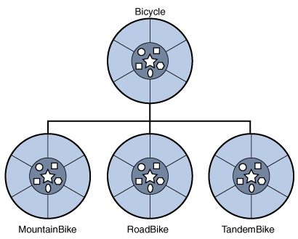
Object Oriented paradigm
An approach to the solution of problems in which all computations are performed in the context of objects.
Objects are instances of classes, which:
are data abstractions
contain procedural abstractions that operate on the objects
object=instance

Slide 9
UML diagram types

Slide 10
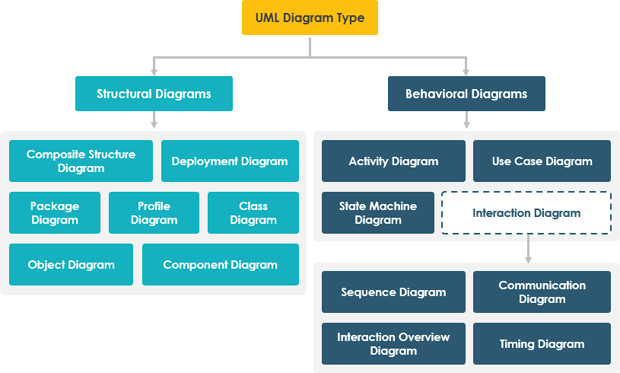
UML diagram types
UML Structural diagrams depict the elements of a system that are independent of time and that convey the concepts of a system and how they relate to each other. The elements in these diagrams resemble the nouns in a natural language, and the relationships that connect them are structural relationships.
UML Behavioural Diagrams depict the elements of a system that are dependent on time and that convey the dynamic concepts of the system and how they relate to each other. The elements in these diagrams resemble the verbs in a natural language and the relationships that connect them typically convey the passage of time.
Source: https://medium.com/@warren2lynch/a-comprehensive-guide-to-14-types-of-uml-diagram-affcc688377e

Slide 11
UML diagram types
Source: https://medium.com/@warren2lynch/a-comprehensive-guide-to-14-types-of-uml-diagram-affcc688377e

Slide 12
Use case diagram
As the most well known diagram type of the behavioural UML types, Use case diagrams give a graphic overview of the actors involved in a system, different functions needed by those actors and how these different functions interact.
You can easily identify the main actors involved and the main processes of the system.

Slide 13
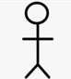
Actor and Use case
An Actor represents anything outside the system that interacts with the system.
Actor:
A Use Case instance is a sequence of transactions performed by the system, which is initiated by a particular actor and yields a meaningful, measurable result of value to a particular actor.

Slide 14
How do we create a use case diagram?
Start with system boundary
Place elements in order to be easy to read
Place actors on the diagram
Conclude by connecting actors to use cases by lines

Slide 15
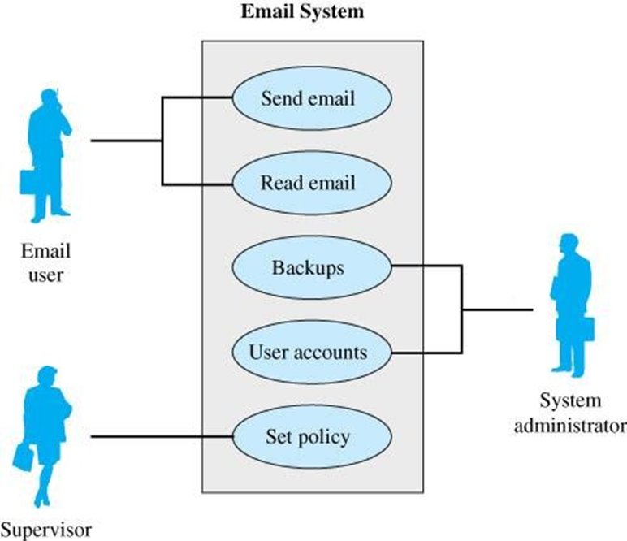
UML Use Case Diagrams
Use Case Diagrams model at a high level
Models how users interact with major components of a system

Slide 16
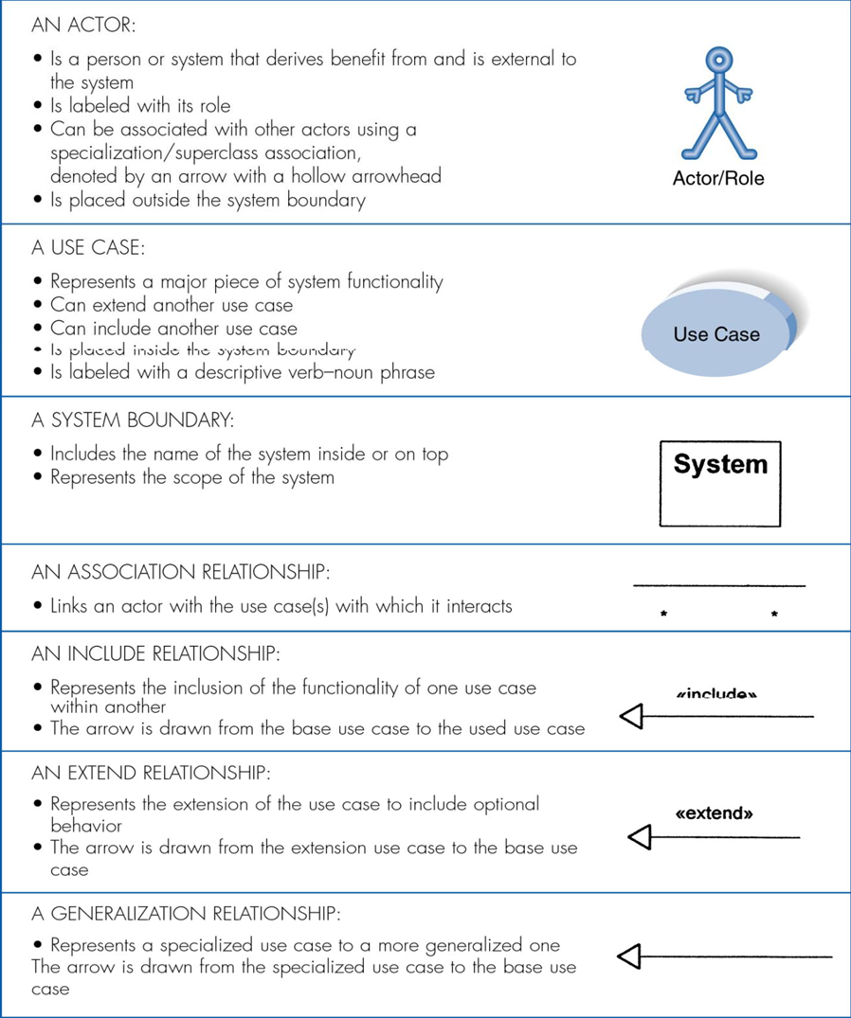
Syntax for use case diagrams
This slide is a useful reference slide
Captures details of the major elements of use case diagrams.

Slide 17
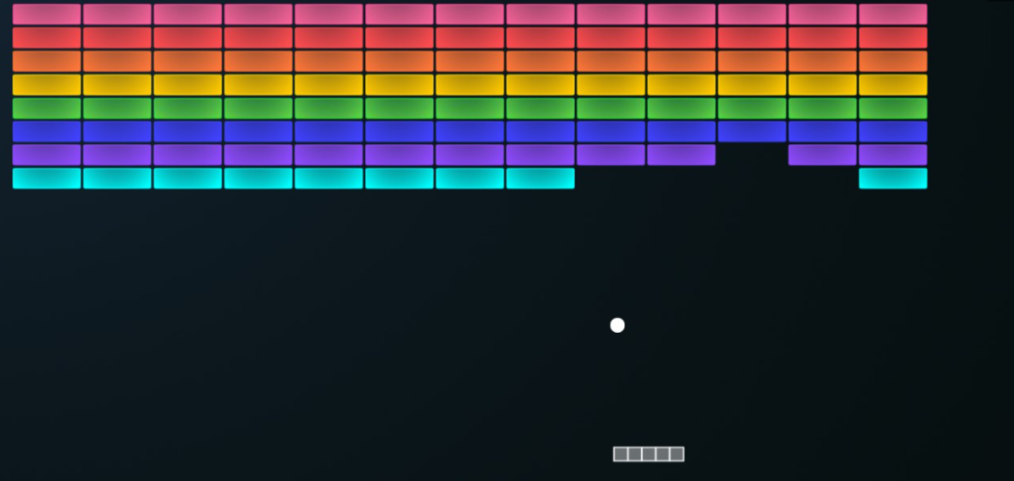

Slide 18
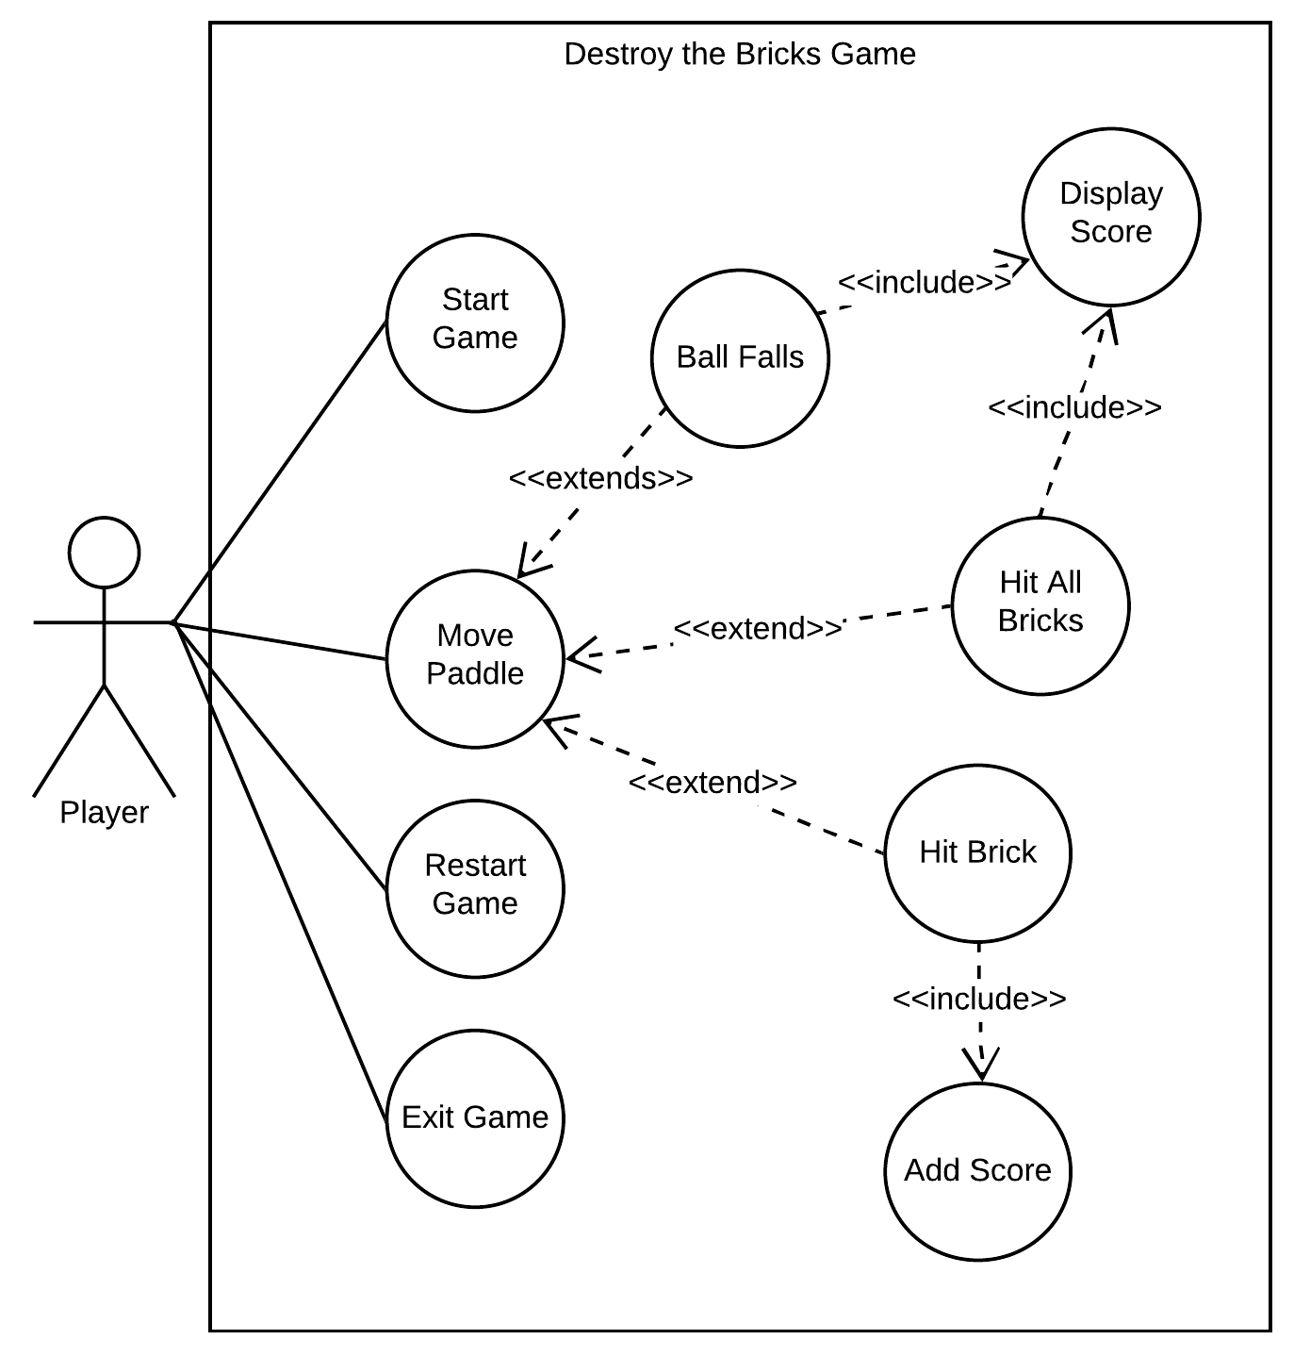
Use case diagram

Slide 19
Breakout Rooms

Slide 20
Breakout Rooms and Teams
Teams tour, recordings, files, channels, week channels
Breakout Channels set up in OOSE Team
Will need to leave this meeting and join a Chanell
Join Channel based on the last digit of your student number (today only)
Report back in meeting chat how many people in each breakout room
Aim is 3 or 4 people in each room
Exercise – take a minute each to explain in your own words what classes and objects are

Slide 21
Directed Learning

Slide 22
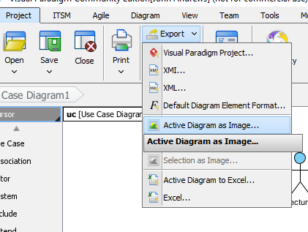
Directed Learning
Labs - Could you include your name in the file name for your upload
Labs - For the moment could you upload single file uploads, not zips – see image for gif export, use vpp if you will lose info by flattening.
Very important that DL is completed
Needs to be completed prior to contact hours
Essentially it’s a pre-requisite for contact hours
In particular videos introduce key introductory concepts that are built on during contact hours – Very important that you have seen the videos prior to contact time
Schedule about an hour for the directed component
Any questions?

Slide 23
Video - LucidChart

Slide 24
https://www.youtube.com/watch?v=zid-MVo7M-E

